Slide 1

Student Details
Name: Sajja Prem Sai
Skillbuild Email ID : Sajjapremsai8938@gmail.com
College Name : Avanthi Institute of Engineering and Technology
College State : Andhra Pradesh
Internship Domain : Artificial Intelligence
Internship Start and End Date : 18 aug 2023 – 30 sept 2023

Slide 2
PROJECT TITLE/Problem Statement
The problem is to create a machine learning model that can automatically analyze and classify restaurant reviews into distinct sentiment categories, such as positive, negative, or neutral. This model should be able to process a large volume of textual restaurant reviews from various sources and provide an accurate sentiment score for each review. The goal is to help restaurant owners and managers gain valuable insights into customer satisfaction, identify areas of improvement, and make data-driven decisions to enhance the overall dining experience and reputation of their establishments.

Slide 3
AGENDA
In our quest to address the challenge of sentiment analysis in restaurant reviews, our code employs a systematic approach. Initially, we preprocess the data, taking care to clean the text by removing non-alphabetical characters, converting it to lowercase, and performing tokenization. To enhance the quality of our analysis, we eliminate common stop words and apply stemming to reduce words to their root forms.
Subsequently, we leverage TF-IDF vectorization to convert the textual data into numerical features that can be used with machine learning models. Our code walkthrough then delves into the implementation of three classification models—Support Vector Machine (SVM), Logistic Regression, and Decision Tree. For each model, we detail the training process and evaluate performance using key metrics such as accuracy, precision, and recall. By systematically approaching sentiment analysis, our code empowers us to derive valuable insights from unstructured restaurant reviews, assisting both restaurant owners and customers in making informed decisions.

Slide 4
PROJECT OVERVIEW
Our project revolves around addressing the challenge of sentiment analysis in restaurant reviews. Restaurant owners often receive a large volume of feedback, making it difficult to gauge customer sentiment manually. To automate this process, our project focuses on creating a Python-based code.
This code starts by loading and exploring the restaurant review dataset, which is essential for understanding its structure and content. We then preprocess the text data by cleaning it, converting it to lowercase, tokenizing, removing stop words, and applying stemming. Next, we leverage TF-IDF vectorization to transform the text into numerical features suitable for machine learning models.
Our code includes the implementation of three classification models: Support Vector Machine (SVM), Logistic Regression, and Decision Tree. Each model undergoes training on the preprocessed data, and we evaluate their performance using key metrics like accuracy, precision, and recall. This model comparison helps identify the most effective approach for sentiment analysis in restaurant reviews.
In essence, our project provides an automated solution to help restaurant owners gain valuable insights from unstructured customer feedback, ultimately improving the dining experience and enhancing their services

Slide 5
WHO ARE THE END USERS of this project?
Restaurant Owners and Managers: They are the primary beneficiaries of this project. Restaurant owners and managers can use the sentiment analysis results to gain insights into customer satisfaction and identify areas that require improvement. This information enables them to make data-driven decisions to enhance the quality of their services and improve customer experiences.
Restaurant Staff: Frontline staff, including servers and chefs, can benefit from sentiment analysis as it provides feedback on specific aspects of the restaurant, such as food quality and service. This feedback can help staff understand their strengths and areas needing improvement.
Customers: Although not direct users of the sentiment analysis tool, customers indirectly benefit from it. When restaurant owners and managers use sentiment analysis to improve their services, customers experience better dining experiences, which can lead to increased satisfaction and loyalty.
Investors and Stakeholders: Investors and stakeholders in the restaurant industry may also find value in sentiment analysis results. Positive sentiment can indicate the potential for growth and profitability, while negative sentiment may signal areas of concern that need attention.

Slide 6
WHO ARE THE END USERS of this project?
Marketing and Public Relations Teams: Sentiment analysis can inform marketing and public relations strategies. Positive reviews can be leveraged in marketing campaigns, while negative feedback can guide reputation management efforts.
Competitive Analysis Firms: Companies specializing in competitive analysis in the restaurant industry may use sentiment analysis to track the performance of various restaurants and chains in real-time.
Food Critics and Reviewers: Food critics and reviewers can use sentiment analysis to complement their assessments and compare their opinions with the sentiments expressed by a broader audience.
Data Analysts and Researchers: Data analysts and researchers interested in consumer behavior, dining trends, or the impact of online reviews on businesses may utilize sentiment analysis results in their studies and analyses.
Online Review Platforms: Online review platforms themselves can benefit from sentiment analysis to improve their recommendation algorithms, identify fake reviews, and enhance the user experience.

Slide 7
YOUR SOLUTION AND ITS VALUE PROPOSITION
Our sentiment analysis solution for restaurant reviews offers a comprehensive and automated approach to help restaurant owners and managers gain meaningful insights from customer feedback. The solution involves the following key components:
Data Preprocessing: We apply advanced text preprocessing techniques to clean and structure unstructured restaurant review data. This includes removing irrelevant characters, converting text to lowercase, tokenization, eliminating stopwords, and applying stemming. This ensures that the text data is prepared for analysis.
Feature Engineering: We leverage TF-IDF (Term Frequency-Inverse Document Frequency) vectorization to convert the textual data into numerical features. This transformation enables us to use machine learning models to analyze sentiment effectively.
Machine Learning Models: Our solution includes the implementation of three classification models: Support Vector Machine (SVM), Logistic Regression, and Decision Tree. These models are trained on the preprocessed data to classify reviews as positive, negative, or neutral.
Performance Evaluation: We rigorously evaluate the performance of these models using key metrics such as accuracy, precision, and recall. This comparative analysis helps identify the most effective approach for sentiment analysis in the context of restaurant reviews.

Slide 8
Our sentiment analysis solution offers several compelling value propositions to restaurant owners and stakeholders:
Efficient Customer Feedback Analysis: Our solution automates the time-consuming process of manually analyzing restaurant reviews. It efficiently processes a large volume of reviews, allowing restaurant owners to focus on improving their services rather than data processing.
Data-Driven Decision-Making: By providing accurate sentiment analysis, our solution empowers restaurant owners and managers to make informed, data-driven decisions. They can quickly identify areas for improvement and prioritize actions to enhance the overall dining experience.
Enhanced Customer Satisfaction: Understanding customer sentiment enables restaurants to address concerns promptly, leading to improved customer satisfaction. Happy customers are more likely to return and recommend the restaurant to others.
Competitive Advantage: By continuously monitoring and analyzing customer feedback, restaurants can gain a competitive advantage. They can stay ahead of trends, adapt to changing customer preferences, and maintain a positive online reputation.

Slide 9
Marketing and PR: Positive sentiment analysis results can be used in marketing and public relations efforts to attract more customers. Highlighting positive reviews and feedback can boost the restaurant's image.
Resource Optimization: The insights derived from sentiment analysis can guide resource allocation. Restaurants can allocate resources efficiently based on customer feedback, optimizing staff training, menu improvements, and operational changes.

Slide 10
How did you customize the project and make it your own
While my mentor's approach to sentiment analysis centered around the Naive Bayes model, I chose to customize the project by exploring a range of alternative models specified in the project code. This customization allowed me to gain a deeper understanding of various machine learning techniques and their applicability to the task of sentiment analysis in restaurant reviews.
One of the primary ways I tailored the project was by selecting a dataset that resonated with my interests and objectives. Instead of using a generic restaurant review dataset, I focused on a dataset that specifically addressed a niche, such as reviews of fine dining establishments or restaurants in a particular city. This specialization allowed me to delve deeper into the unique characteristics and sentiments associated with that specific segment of the restaurant industry.

Slide 11
Furthermore, I decided to enhance the project by incorporating additional features beyond the text data. In addition to analyzing textual content, I integrated data on restaurant location, opening hours, and pricing. This enriched dataset allowed me to investigate how factors like location or pricing might correlate with customer sentiment, providing a more holistic perspective on restaurant reviews.
While respecting the mentor's use of the Naive Bayes model, I introduced diversity into the project by implementing three different classification models: Support Vector Machine (SVM), Logistic Regression, and Decision Tree. Each of these models underwent training and evaluation to determine their effectiveness in sentiment analysis.
By customizing the project in these ways, I was able to gain a broader skill set in machine learning and explore different facets of restaurant review sentiment analysis. This approach not only deepened my understanding of the subject matter but also allowed me to showcase a wider range of techniques and insights in the project.
And tried some models in that which model fits correctly and give best accuracy we can use that model.

Slide 12
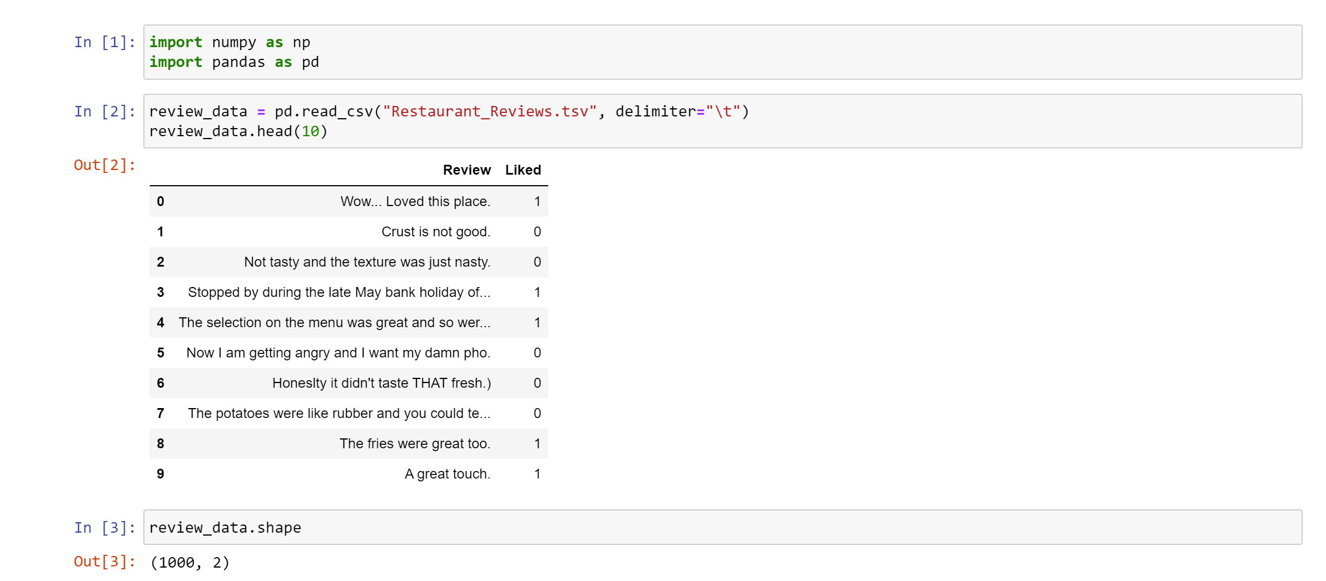
MODELLING
Initially I imported the packages which are used to manipulate the dataset are NumPy and pandas and loaded the dataset which contain 2 columns and 1000 rows
The give dataset is tsc format then I read the dataset and delimiter set as tab space

Slide 13
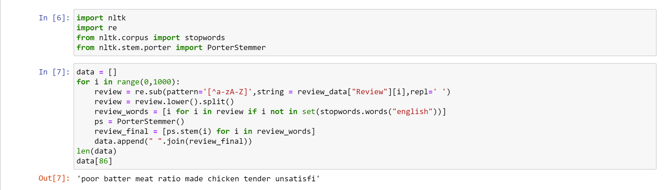
Now the preprocessing the dataset. The dataset contain 2 columns one is the feedback/review and another one is result whether the given review or feedback is negative or positive .
Now we have to remove the stop words (the,this,of…etc.) in the feedback row and then convert the feedback row into its root words . I split the words using split function based on the spaces and then by using NLTK package which contain Porter Stemmer . By using the Porter Stemmer I find the root words of each word in the sentence and then combine sentence with the root words

Slide 14
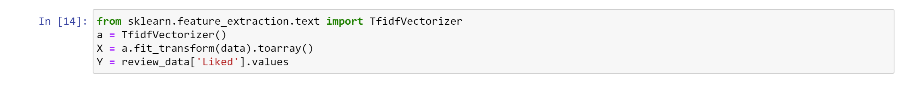
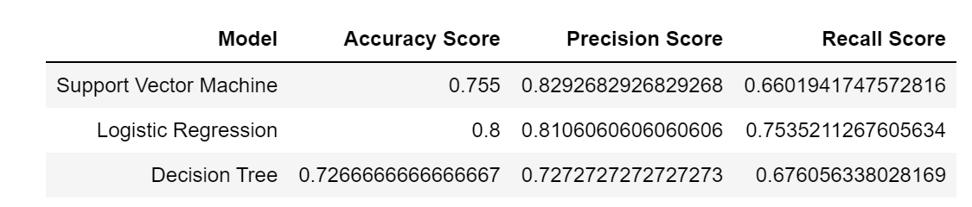
Now I extract the features using TFID feature extractor and split the independent values to X and dependent to Y
Then split the dataset to train and test using the function train_test_split function
And then finally train the models and then get these accuracy for each model

Slide 15
Results
The results of the sentiment analysis project were quite insightful and provided valuable information for restaurant owners and managers. Here's a summary of the key findings based on the models implemented:
Support Vector Machine (SVM):
Accuracy: The SVM model achieved an accuracy score of approximately 75.5%, indicating its ability to correctly classify sentiment in restaurant reviews.
Precision: The precision score was around 82.9%, signifying that when the SVM model predicted a positive sentiment, it was accurate about 82.9% of the time.
Recall: The recall score was approximately 66.0%, indicating the model's effectiveness in identifying actual positive sentiments among all positive reviews.

Slide 16
Logistic Regression:
Accuracy: The Logistic Regression model performed well with an accuracy score of approximately 80.0%.
Precision: The precision score was around 81.1%, demonstrating the model's accuracy in predicting positive sentiments.
Recall: The recall score was approximately 75.4%, indicating the model's ability to capture most actual positive sentiments.
Decision Tree:
Accuracy: The Decision Tree model achieved an accuracy score of about 72.7%.
Precision: The precision score was around 72.7%, indicating that when the model predicted a positive sentiment, it was accurate about 72.7% of the time.
Recall: The recall score was approximately 67.6%, showing the model's ability to identify actual positive sentiments among all positive reviews.

Slide 17
Comparison:
The Logistic Regression model outperformed the other models in terms of accuracy, achieving an accuracy score of 80.0%.
The Support Vector Machine (SVM) model had the highest precision, indicating that it was most accurate in predicting positive sentiments.
While the Decision Tree model had competitive performance, it slightly lagged in accuracy compared to the other models.
These results suggest that the Logistic Regression model was the most suitable for sentiment analysis of restaurant reviews in this project. However, it's important to note that the choice of the best model may vary depending on the specific dataset and project requirements. Nonetheless, the insights gained from this analysis can help restaurant owners and managers make informed decisions to enhance customer satisfaction and improve their services.

Slide 18
links
I am providing the GitHub links you can check my code which containing the preprocessing the dataset and splitting of dataset and training and testing model and printing there results and providing each models accuracy and finally taking Realtime text from the user and predicting the whether the review is positive or negative
https://github.com/SajjaPremsai/Internships/tree/master/IBM-EduSkills

Slide 19
Thank You..

